Slide 1

VIBE MODE: ON!
AGILE PUNE 2025 CONFERENCE
Theme: Sankalp to Siddhi - Resolution to Realization
VISION INNOVATION BUILD ENGINEERING
Notes:
AI-generated content may be incorrect. ---

Slide 2
Disclaimer
Personal Views Disclaimer
The content reflects the presenter’s personal opinions and not official company policies or stances.
Demonstration Purposes Only
All shared code and technical content are for demonstration only, not production-ready or for live environments.
Tool Limitations
Tools shown are free or community versions with limited capabilities compared to enterprise or paid versions.
Responsible Usage Encouraged
Attendees should apply responsible AI practices and follow organizational ethical guidelines when implementing solutions.

Slide 3




KNOW THE SPEAKERS'
Abhijit Shah
Principal Architect
Yogesh Umbarkar
Sr. Project Manager
Mugdha Shah
Product Manager
Harshad More
Sr. Technology Architect
Notes:
Meet the Hosts

Slide 4

Workshop Agenda
Workshop Introduction
Combining human creativity with AI Agents to build software effectively.
Getting Started
Discussion on hallucination & ensuring secure, RAI application in coding.
Responsible AI Use
Hands-on Prototyping and Techniques
Objective - Attendees transform prompts into prototypes using Agentic capabilities of Vibe coding platforms.
Example 1 -Solving the real-world problems and Innovate with Empathy
Example 2 - Build the StudyMate application
Example 3 - Vibe Coding with Agile Development Way
Exciting Path ahead and Career Opportunities
Notes:
The workshop is structured to provide a comprehensive learning experience through a series of interactive segments. It begins with a welcome and safety briefing, followed by an introduction to vibe coding concepts, patterns, and common pitfalls. Participants will then set up essential tools including Google AI Studio, Firebase, and GitHub Copilot. The core of the workshop involves hands-on activities where students will transform prompts into working prototypes, engage in pair programming with AI, and implement coding, testing, and documentation practices. A show-and-tell session allows students to present their work and receive feedback. The workshop concludes with a discussion on career pathways and next steps, helping students understand how to leverage their new skills for internships and job opportunities. This structured flow ensures that students not only learn but also apply their knowledge in a meaningful way.

Slide 5
VIBE MODE: ON ! LET’S VIBE
Notes:
Benefits and Industry Relevance

Slide 6








RESPONSIBLE ENGINEERING
Direction > Instruction
Iterative Development
Importance of Context
Hallucinations
Not just what AI should do, but how it should do it
Refine inputs step-by- step, like Agile sprints
Clear, detailed context leads to accurate results
AI can add details that don’t exist, always verify the output

Slide 7

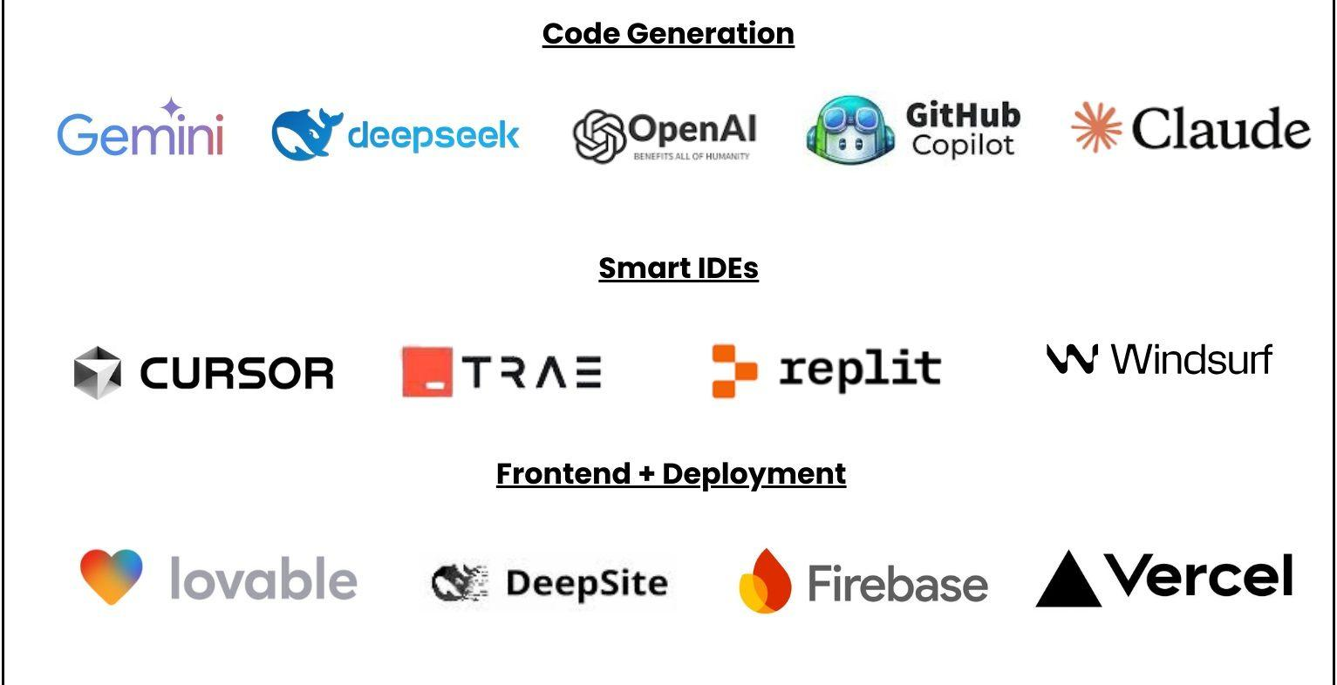



Vibe Coding Tools

Slide 8
Live Prototyping with Vibe Coding Tools
Workshop Objective
Attendees transform prompts into prototypes using Agentic capabilities of Vibe coding platforms.
Example 1
Solving the real-world problems and Innovate with Empathy
Example 2
Build the “StudyMate” application
Example 3
Vibe Coding with Agile Development Way

Slide 9
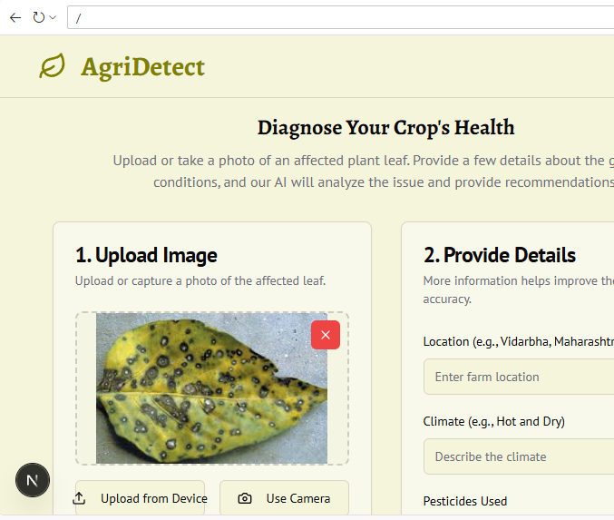
SOLVING THE REAL-WORLD PROBLEMS AND INNOVATE WITH EMPATHY
EXAMPLE 1
AGRI DIRECT

Slide 10
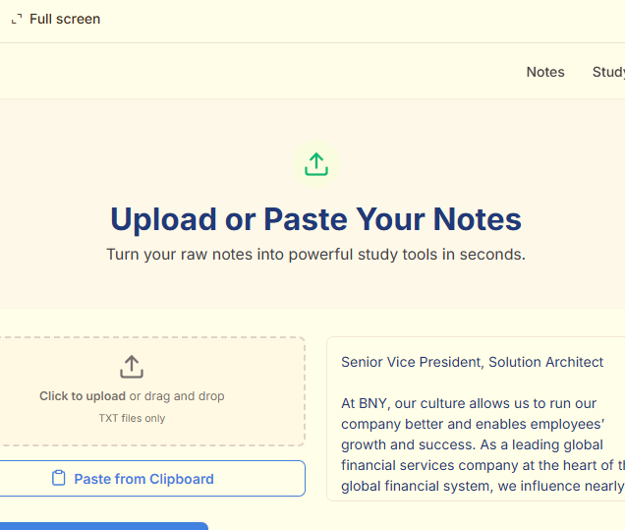

GOAL: HELP COLLEGE STUDENTS CREATE STUDY-MATE, AN AI-POWERED STUDY AND INTERVIEW PREP ASSISTANT USING GOOGLE AI STUDIO , CHATGPT, ETC.
EXAMPLE 2
STUDY-MATE

Slide 11
Study Mate
Goal
Create a single-page web app called StudyMate that helps college students accelerate their studies and prepare for corporate interviews using AI-generated quizzes, flashcards, and personalized learning insights.
Detailed Prompt for AI App Generator
Prompt Title: 📚 StudyMate – AI Study & Interview Assistant for College Students
App Description
Build a modern, responsive single-page web app named StudyMate, designed to help college students study smarter and prepare for corporate job interviews. The app should use AI to convert class notes, PDFs, or text input into quizzes, flashcards, summaries, and provide interview prep assistance (common HR, technical, and aptitude questions).
Core Features
Upload or Paste Notes
Allow students to upload PDFs / Word / Text files or paste text directly.
AI should parse the content and generate study materials.
AI Quiz & Flashcard Generator
Automatically create quizzes (MCQs, short answers, or true/false) from uploaded notes.
Create AI flashcards (Question on front, Answer on back).
Allow export of flashcards as .csv or .pdf.
Smart Summaries
Generate concise, AI-driven summaries of uploaded material.
Allow students to select “Quick Recap” or “Detailed Review.”
Interview Preparation Mode
Preloaded corporate interview question banks:
General HR questions
Technical (by domain: IT, Finance, Marketing, etc.)
Aptitude & reasoning
AI should analyze uploaded resume (optional) and suggest personalized interview questions.
Progress Tracker
Simple visual analytics dashboard:
Number of quizzes attempted
Accuracy %
Weak topic areas (based on quiz performance)
Suggested improvement areas.
AI Chat Assistant
Integrated chatbot: “Ask StudyMate” for any question based on uploaded content.
Supports follow-up questions and rephrased explanations.
UI & UX Requirements
Modern single-page layout using React.js (or Next.js) + Tailwind CSS.
Soft pastel theme (blue/white/green focus-friendly colors).
Sections in scrollable format:
Header → Upload Notes → Flashcards/Quiz → Interview Prep → Analytics → Chat.
Include icons & light animations (Fluent UI preferred).
Tech Stack (suggested)
Frontend: React.js + Tailwind CSS
AI Backend: OpenAI API (or local LLM API placeholder)
Storage: LocalStorage / Firebase for user progress
Optional: Audio-based notes
Notes:
Goal
Create a single-page web app called StudyMate that helps college students accelerate their studies and prepare for corporate interviews using AI-generated quizzes, flashcards, and personalized learning insights.
Detailed Prompt for AI App Generator
Prompt Title: 📚 StudyMate – AI Study & Interview Assistant for College Students
App Description
Build a modern, responsive single-page web app named StudyMate, designed to help college students study smarter and prepare for corporate job interviews. The app should use AI to convert class notes, PDFs, or text input into quizzes, flashcards, summaries, and provide interview prep assistance (common HR, technical, and aptitude questions).
Core Features
Upload or Paste Notes
Allow students to upload PDFs / Word / Text files or paste text directly.
AI should parse the content and generate study materials.
AI Quiz & Flashcard Generator
Automatically create quizzes (MCQs, short answers, or true/false) from uploaded notes.
Create AI flashcards (Question on front, Answer on back).
Allow export of flashcards as .csv or .pdf.
Smart Summaries
Generate concise, AI-driven summaries of uploaded material.
Allow students to select “Quick Recap” or “Detailed Review.”
Interview Preparation Mode
Preloaded corporate interview question banks:
General HR questions
Technical (by domain: IT, Finance, Marketing, etc.)
Aptitude & reasoning
AI should analyze uploaded resume (optional) and suggest personalized interview questions.
Progress Tracker
Simple visual analytics dashboard:
Number of quizzes attempted
Accuracy %
Weak topic areas (based on quiz performance)
Suggested improvement areas.
AI Chat Assistant
Integrated chatbot: “Ask StudyMate” for any question based on uploaded content.
Supports follow-up questions and rephrased explanations.
UI & UX Requirements
Modern single-page layout using React.js (or Next.js) + Tailwind CSS.
Soft pastel theme (blue/white/green focus-friendly colors).
Sections in scrollable format:
Header → Upload Notes → Flashcards/Quiz → Interview Prep → Analytics → Chat.
Include icons & light animations (Fluent UI preferred).
Tech Stack (suggested)
Frontend: React.js + Tailwind CSS
AI Backend: OpenAI API (or local LLM API placeholder)
Storage: LocalStorage / Firebase for user progress
Optional: Audio-based notes

Slide 12
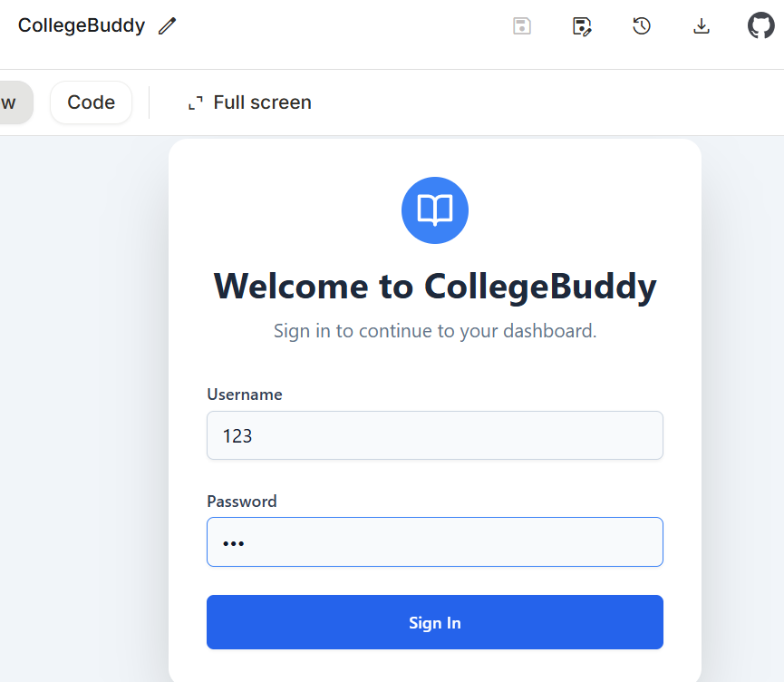
GOAL – BUILD AN APP FOR STUDY MATERIAL SHARING, PEER STUDY, Q&A FOR CLASSWORK/HOMEWORK (MUST-HAVE) AND CHAT BOX, PARTY PLANNING, TRIP PLANNING
EXAMPLE 2
COLLEGE-BUDDY

Slide 13
VIBE CODING 2.0- FOR ENTERPRISES

Slide 14
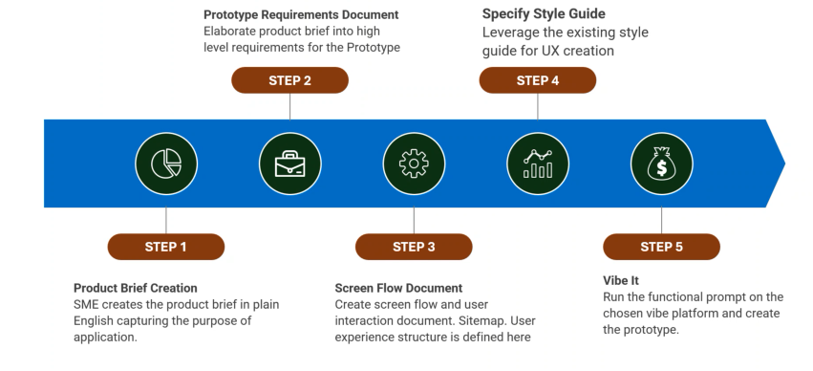
Vibe Coding / Prototyping Approach

Slide 15



STEP 1: Product Brief Creation
Role of Subject Matter Expert
The SME drafts the product brief in simple language to clearly define the application’s purpose.
Purpose of Product Brief
The brief captures the application's goals, target audience, and key functionalities concisely.
Importance for Stakeholders
It ensures shared understanding and aligns expectations among all project stakeholders.
Notes:
The first step in the rapid prototyping approach is the creation of a product brief. This task is typically undertaken by the Subject Matter Expert (SME), who drafts the brief in plain English. The primary objective of this document is to capture the purpose of the application in a clear and concise manner. It serves as the foundational blueprint that guides all subsequent stages of the prototyping process. By articulating the application's goals, target audience, and key functionalities, the product brief ensures that all stakeholders have a shared understanding of the project's direction. This clarity is crucial for aligning expectations and setting the stage for effective collaboration among designers, developers, and business teams.

Slide 16



STEP 2: Prototype Requirements Document
From Brief to Requirements
The prototype requirements document transforms the initial product brief into actionable and detailed specifications.
Core Features and Constraints
It clearly defines core features, user interactions, and technical constraints for the prototype development.
Roadmap for Development
This document provides a clear roadmap for design, development, resource planning, and early challenge identification.
Notes:
Following the creation of the product brief, the next step involves elaborating it into a high-level requirements document for the prototype. This document translates the conceptual ideas from the brief into actionable specifications. It outlines the core features, user interactions, and technical constraints that the prototype must address. By detailing these requirements, the team can ensure that the prototype aligns with the intended functionality and user experience. This step is critical for minimizing ambiguities and providing a clear roadmap for the design and development phases. It also facilitates better resource planning and helps in identifying potential challenges early in the process.

Slide 17

STEP 3: Screen Flow Document
Mapping User Navigation
Screen flow documents map how users navigate through each screen and transition within the application.
Designing Sitemap Structure
A sitemap defines the overall structure and hierarchy of the user experience in the application design.
Enhancing Usability
This document helps identify usability issues and optimize layout for intuitive and engaging user experience.
Step 3 – Prompt :
Now for the attached product requirement document, create a Screen flow Document that describes the user journey and show case the capabilities of the product. Create the output in the .Docx format.
Notes:
The third step focuses on creating a screen flow and user interaction document. This involves designing a sitemap and defining the structure of the user experience. The screen flow document maps out how users will navigate through the application, detailing each screen and the transitions between them. It serves as a visual guide that helps designers and developers understand the intended user journey. By establishing a coherent flow, this document ensures that the application is intuitive and user-friendly. It also aids in identifying potential usability issues and optimizing the layout for better engagement. This step is essential for translating abstract requirements into tangible design elements.

Slide 18

STEP 4: Specify Style Guide
Leveraging Brand Guidelines
Utilize existing brand guidelines to maintain visual consistency throughout the UX prototype.
Style Guide Components
Include color schemes, typography, iconography, and spacing rules in the style guide for cohesive design.
Benefits of Style Guide
Enhances usability, aesthetic appeal, and streamlines design by providing predefined templates and components.
Notes:
In the fourth step, the team specifies the style guide to be used for the user experience (UX) creation. This involves leveraging existing brand guidelines to maintain visual consistency across the prototype. The style guide includes elements such as color schemes, typography, iconography, and spacing rules. By adhering to these standards, the prototype not only reflects the brand identity but also enhances usability and aesthetic appeal. This step ensures that the design is cohesive and professional, which is crucial for user trust and engagement. It also streamlines the design process by providing predefined templates and components, thereby reducing the time and effort required for customization.

Slide 19

STEP 5: Vibe It
Interactive Prototype Creation
The 'Vibe It' step generates interactive mockups automatically from previous design inputs, creating a functional prototype.
Design Validation and Feedback
This phase enables testing of usability and design assumptions, helping teams gather feedback early in development.
Risk Reduction and Efficiency
Early prototype testing helps identify issues sooner, reducing development risks and improving project efficiency.
Stakeholder Experience
The prototype allows stakeholders to experience the application in a simulated environment before full development.
Notes:
The final step in the rapid prototyping approach is to 'Vibe It'. This involves running the functional prompt on the chosen vibe platform to create the actual prototype. The vibe platform automates the generation of interactive mockups based on the inputs provided in the previous steps. It allows teams to quickly visualize and test the application’s functionality and user experience. This step is crucial for validating design assumptions and gathering feedback before moving into full-scale development. By producing a working prototype, teams can identify and address issues early, thereby reducing development risks and improving overall efficiency. The 'Vibe It' phase brings the concept to life, enabling stakeholders to experience the application in a simulated environment.

Slide 20
LEARNING OUTCOMES AND CAREER IMPACT
Notes:
Skills and Opportunities

Slide 21
Key Learnings
Live GenAI App Prototyping Hands-on experience building a multi-modal apps using Vibe coding platforms like GitHub Copilot, Google AI Studio or Google Firebase Studio.
Vibe Coding and Agentic Collaboration Learn how to co-create with AI Agents with XP-style collaboration and Agentic capabilities to boost speed, creativity, and code quality.
Vibe coding and Prompt Engineering Practice writing effective prompts for ideation, design, coding, testing, and documentation.
Responsible GenAI Use Gain a mental model for secure, ethical, and environmentally conscious GenAI development—avoiding hallucinations and misuse.
Internship & Career Readiness Map GenAI skills to real-world roles, showcasing how vibe coding accelerates onboarding and productivity in entry-level tech jobs.

Slide 22
NEXT STEPS AND CAREER READINESS
Notes:
Building Your Portfolio

Slide 23

Building Your Portfolio
Create Public Repositories
Students can document their prompts and learning outcomes in public repositories to showcase their work.
Showcase Technical Projects
Projects using AI Studio, Firebase, and Copilot demonstrate technical skills and innovation in portfolios.
Engage in Continuous Learning
Continuous learning, open-source contributions, and hackathons improve visibility and career opportunities.
Prepare for Career Readiness
A strong portfolio with real skills makes students attractive for internships and entry-level roles.
Notes:
After the workshop, students are encouraged to continue building their skills and showcasing their work. They can create public repositories that document their prompts, decisions, and learning outcomes. Projects developed using AI Studio, Firebase, and Copilot can serve as strong portfolio pieces that demonstrate technical proficiency and innovation. Students should aim to build a portfolio that highlights real skills and outcomes, making them attractive candidates for internships and entry-level roles. By engaging in continuous learning, contributing to open-source projects, and participating in hackathons, students can further enhance their visibility and credibility in the tech industry. This proactive approach to career readiness ensures that students are well-prepared to seize opportunities in modern software engineering.

Slide 24

THANK YOU

